Slide 1
Algorithms
Sorting in Linear Time
Dr. Ashish Sharma
David Luebke <number> 11/07/26

Slide 2
Non-Comparison Based Sorting
Many times we have restrictions on our keys
  Deck of cards: Ace->King and four suites
  Social Security Numbers
  Employee ID’s
We will examine three algorithms which under certain conditions can run in O(n) time.
  Counting sort
  Radix sort
  Bucket sort

Slide 3
Counting Sort
Depends on assumption about the numbers being sorted
  Assume numbers are in the range 1.. k
The algorithm:
  Input: A[1..n], where A[j] ∈ {1, 2, 3, …, k}
  Output: B[1..n], sorted (not sorted in place)
  Also: Array C[1..k] for auxiliary storage

Slide 4
Counting Sort
1 CountingSort(A, B, k)
2 for i=0 to k
3 C[i]= 0;
4 for j=1 to n
5 C[A[j]] = C[A[j]] + 1;
6 for i=1 to k
7 C[i] = C[i] + C[i-1];
8 for j=n downto 1
9 B[C[A[j]]] = A[j];
10 C[A[j]] = C[A[j]] - 1;

Slide 5
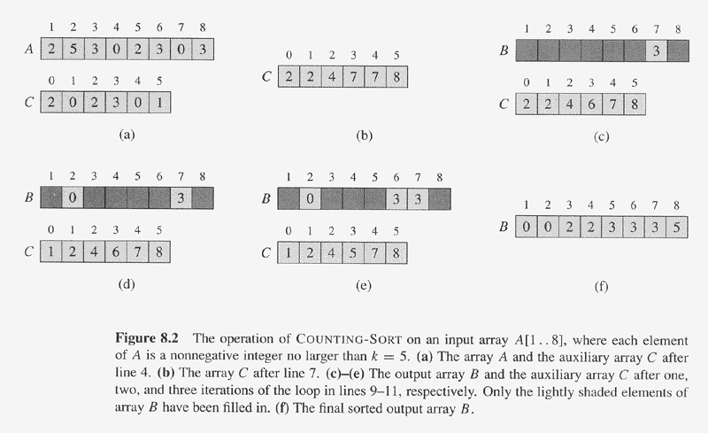
Counting Sort Example

Slide 6
Counting Sort
1 CountingSort(A, B, k)
2 for i=0 to k
3 C[i]= 0;
4 for j=1 to n
5 C[A[j]] = C[A[j]] - 1;
6 for i=1 to k
7 C[i] = C[i] + C[i-1];
8 for j=n downto 1
9 B[C[A[j]]] = A[j];
10 C[A[j]] = C[A[j]] - 1;
Takes time O(k)
Takes time O(n)
What is the running time?

Slide 7
Counting Sort
Total time: O(n + k)
  Works well if k = O(n) or k = O(1)
This algorithm / implementation is stable.
  A sorting algorithm is stable when numbers with the same values appear in the output array in the same order as they do in the input array.

Slide 8
Counting Sort
Why don’t we always use counting sort?
  Depends on range k of elements.
Could we use counting sort to sort 32 bit integers? Why or why not?

Slide 9
Counting Sort Review
Assumption: input taken from small set of numbers of size k
Basic idea:
  Count number of elements less than you for each element.
  This gives the position of that number – similar to selection sort.
Pro’s:
  Fast
  Asymptotically fast - O(n+k)
  Simple to code
Con’s:
  Doesn’t sort in place.
  Elements must be integers.
  Requires O(n+k) extra storage.
countable

Slide 10
Radix Sort
How did IBM get rich originally?
Answer: punched card readers for census tabulation in early 1900’s.
  In particular, a card sorter that could sort cards into different bins
    Each column can be punched in 12 places
    Decimal digits use 10 places
  Problem: only one column can be sorted on at a time

Slide 11
Radix Sort
Intuitively, you might sort on the most significant digit, then the second msd, etc.
Problem: lots of intermediate piles of cards (read: scratch arrays) to keep track of
Key idea: sort the least significant digit first
  RadixSort(A, d)
  for i=1 to d
  StableSort(A) on digit i

Slide 12
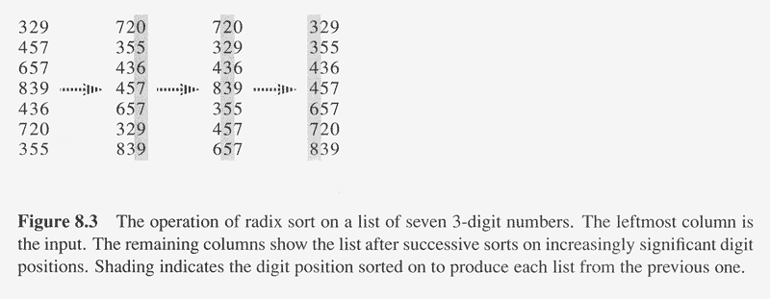
Radix Sort Example

Slide 13
Radix Sort Correctness
Sketch of an inductive proof of correctness (induction on the number of passes):
  Assume lower-order digits {j: j<i }are sorted
  Show that sorting next digit i leaves array correctly sorted
    If two digits at position i are different, ordering numbers by that digit is correct (lower-order digits irrelevant)
    If they are the same, numbers are already sorted on the lower-order digits. Since we use a stable sort, the numbers stay in the right order

Slide 14
Radix Sort
What sort is used to sort on digits?
Counting sort is obvious choice:
  Sort n numbers on digits that range from 1..k
  Time: O(n + k)
Each pass over n numbers with d digits takes time O(n+k), so total time O(dn+dk)
  When d is constant and k=O(n), takes O(n) time

Slide 15
Radix Sort
Problem: sort 1 million 64-bit numbers
  Treat as four-digit radix 2¹⁶ numbers
  Can sort in just four passes with radix sort!
Performs well compared to typical
O(n lg n) comparison sort
  Approx lg(1,000,000) ≅ 20 comparisons per number being sorted

Slide 16
Radix Sort Review
Assumption: input has d digits ranging from 0 to k
Basic idea:
  Sort elements by digit starting with least significant
  Use a stable sort (like counting sort) for each stage
Pro’s:
  Fast
  Asymptotically fast (i.e., O(n) when d is constant and k=O(n))
  Simple to code
  A good choice
Con’s:
  Doesn’t sort in place
  Not a good choice for floating point numbers or arbitrary strings.

Slide 17
Bucket Sort
Assumption: input elements distributed uniformly over some known range, e.g., [0,1), so all elements in A are greater than or equal to 0 but less than 1 . (Appendix C.2 has definition of uniform distribution)
  Bucket-Sort(A)
  1. n = length[A]
  2. for i = 1 to n
  do insert A[i] into list B[floor of nA[i]]
  4. for i = 0 to n-1
  do sort list i with Insertion-Sort
  6. Concatenate lists B[0], B[1],…,B[n-1]

Slide 18
Bucket Sort
  Bucket-Sort(A, x, y)
  1. divide interval [x, y) into n equal-sized subintervals (buckets)
  2. distribute the n input keys into the buckets
  3. sort the numbers in each bucket (e.g., with insertion sort)
  4. scan the (sorted) buckets in order and produce output array
Running time of bucket sort: O(n) expected time
Step 1: O(1) for each interval = O(n) time total.
Step 2: O(n) time.
Step 3: The expected number of elements in each bucket is O(1)
(see book for formal argument, section 8.4), so total is O(n)
Step 4: O(n) time to scan the n buckets containing a total of n input
elements

Slide 19
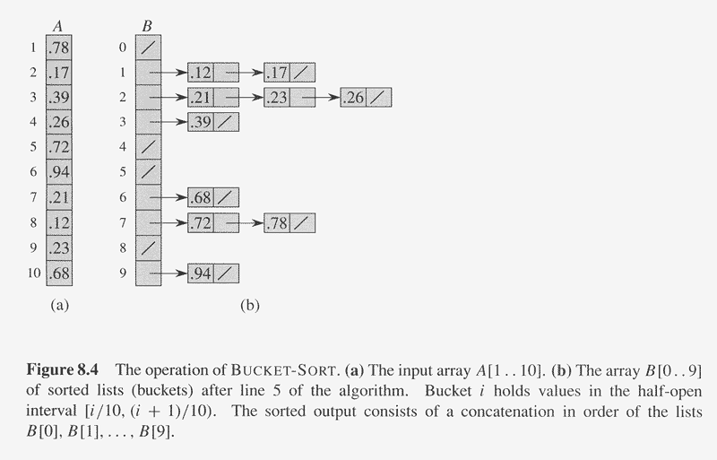
Bucket Sort Example

Slide 20
Bucket Sort Review
Assumption: input is uniformly distributed across a range
Basic idea:
  Partition the range into a fixed number of buckets.
  Toss each element into its appropriate bucket.
  Sort each bucket.
Pro’s:
  Fast
  Asymptotically fast (i.e., O(n) when distribution is uniform)
  Simple to code
  Good for a rough sort.
Con’s:
  Doesn’t sort in place

Slide 21
Summary of Linear Sorting
Non-Comparison Based Sorts
Running Time
worst-case average-case best-case in place
Counting Sort O(n + k) O(n + k) O(n + k) no
Radix Sort O(d(n + k')) O(d(n + k')) O(d(n + k')) no
Bucket Sort O(n) no
Counting sort assumes input elements are in range [0,1,2,..,k] and uses array indexing to count the number of occurrences of each value.
Radix sort assumes each integer consists of d digits, and each digit is in range [1,2,..,k'].
Bucket sort requires advance knowledge of input distribution (sorts n numbers uniformly distributed in range in O(n) time).

